Slide 1
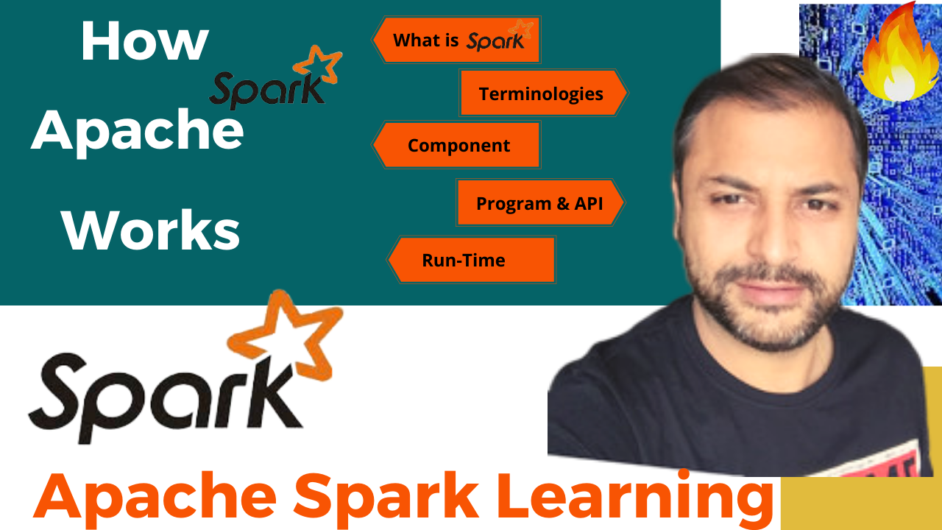
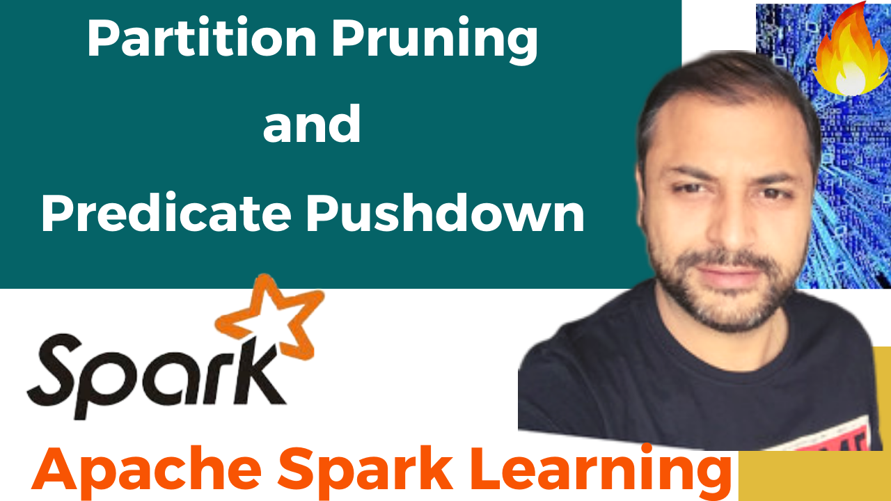


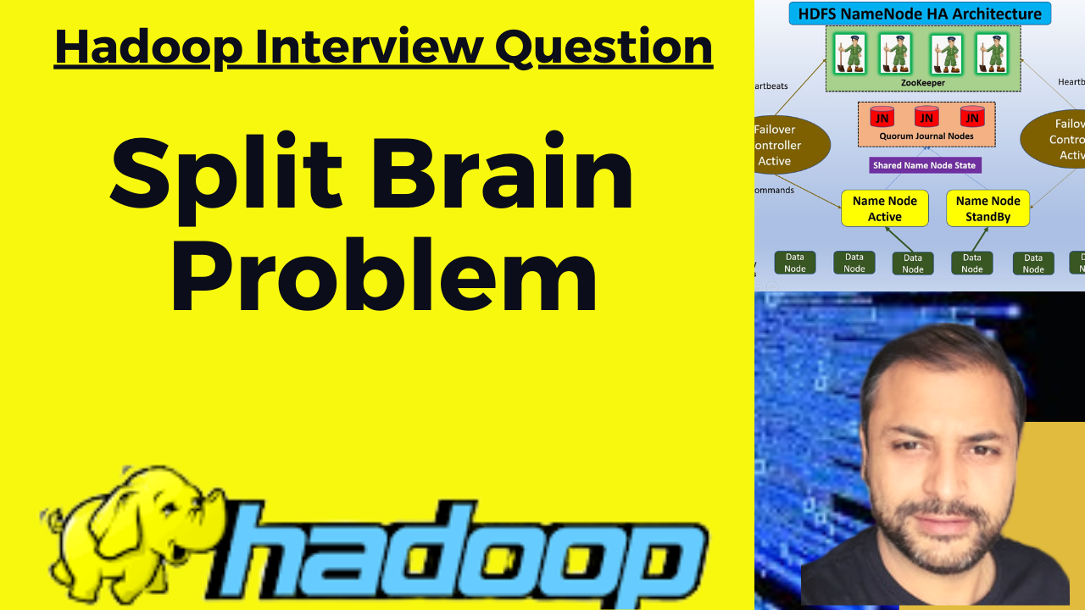


Partition Pruning
&
Predicate Pushdown
Interview Question

Slide 2
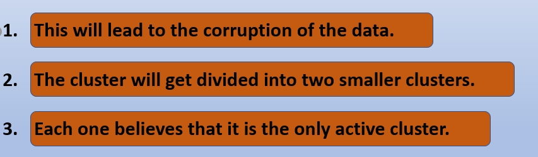

Split Brain Issue
There may happen a scenario in the Hadoop-2 HA architecture, where in
Both the Namenodes (Active and Standby) became active.
In case of a failover, it is possible that the previous Active NameNode could serve read requests to clients, while it is till shutting down,
That will corrupt the metadata from the standby NN perspective as it is already active now.
This is called split-brain-scenario

Slide 3

HDFS NameNode HA Architecture
ZooKeeper
Heartbeats
Heartbeats
Quorum Journal Nodes
JN
JN
JN
Failover Controller
Active
Failover Controller
Active
Shared Name Node State
Commands
Name Node Active
Name Node
StandBy
Block reports to both NN-Active/Standby
DN Fencing - only obeys commands from - Active
Data
Node
Data
Node
Data
Node
Data
Node
Data
Node
Data
Node

Slide 4
Split Brain Issue
Before Hadoop 2.0.0, the NameNode was a single point of failure (SPOF) in an HDFS cluster.
Each cluster had a single NameNode, and if NameNode fails, the cluster as a whole would be out services.
The cluster will be unavailable until the NameNode restarts or brought on a separate machine.
There was no automatic failover solution.

Slide 5

HDFS NameNode HA Architecture
ZooKeeper
Heartbeats
Heartbeats
Quorum Journal Nodes
JN
JN
JN
Failover Controller
Active
Failover Controller
Active
Shared Name Node State
Commands
Name Node Active
Name Node
StandBy
Block reports to both NN-Active/Standby
DN Fencing - only obeys commands from - Active
Data
Node
Data
Node
Data
Node
Data
Node
Data
Node
Data
Node

Slide 6
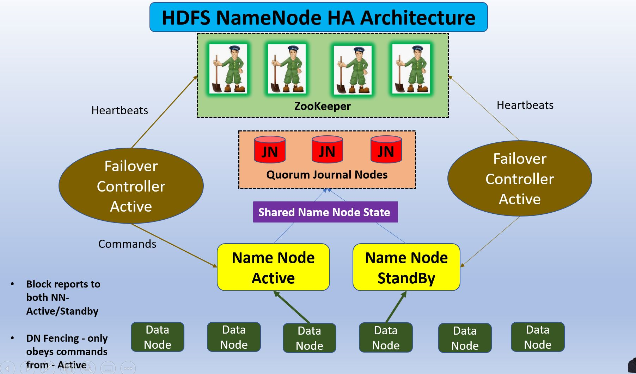
Split Brain Issue
In a typical HA cluster, two separate machines are configured as NameNodes.
At any point in time, exactly one of the NameNodes is in Active state, and the other is in a Standby state.
Active NameNode – It handles all client operations in the cluster.
Passive NameNode – It is a standby namenode, which has similar data as active NameNode. It acts as a slave, maintains enough state to provide a fast failover, if necessary.

Slide 7
Split Brain Issue
In order for the Standby node to keep its state synchronized with the Active node.
Both nodes communicate with a group of separate daemons called "JournalNodes" (JNs).
When any namespace modification is performed by the Active node, it durably logs a record of the modification to these JNs.
The Standby node is capable of reading the edits from the JNs, and is constantly watching them for changes.

Slide 8
Split Brain Issue
As the Standby Node sees the edits, it applies them to its own namespace.
In the event of a failover, the Standby will ensure that it has read all of the edits from the JounalNodes before promoting itself to the Active state.
This ensures that the namespace state is fully synchronized before a failover occurs.

Slide 9
Split Brain Issue
In order to provide a fast failover, it is also necessary that the Standby node have up-to-date information regarding the location of blocks in the cluster.
In order to achieve this, the DataNodes are configured with the location of both NameNodes, and send block location information and heartbeats to both

Slide 10
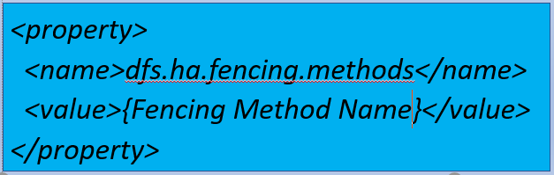

Split Brain Issue : Solution
The JournalNodes will only ever allow a single NameNode to be a writer at a time. Inspite of that for a failover kind of scenarios, solution for split brain problem is available in the form of :
Fencing
We can add Fencing mechanism in the hdfs-site.xml like
Fencing Method Name - a list of scripts or Java classes which will be used to fence the Active NameNode during a failover.

Slide 11
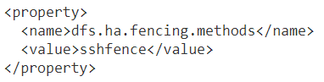
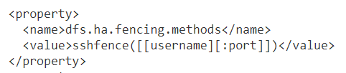

Split Brain Issue : Solution
Fencing Method example:
sshfence - The sshfence option SSHes to the target node and uses fuser to kill the process listening on the service's TCP port

Slide 12
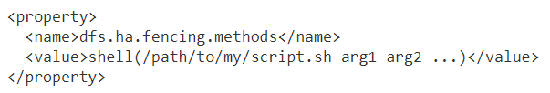
Split Brain Issue : Solution
2. shell - run an arbitrary shell command to fence the Active NameNode

Slide 13
Split Brain Issue
Thanks and do subscribe to my channel

